Slide 1
RISK & RETURNS: THE SHARPE RATIO
N140191
N140205
N140280
N130950
Under Guidance of
Sravan Kumar, Asst. Prof, CSE

Slide 2
Introduction
When you assess whether to invest in an asset, you want to look not only at how much money you could make but also at how much risk you are taking. We use The Sharpe Ratio, developed by Nobel Prize winner William Sharpe and relate this return to the risk of the investment.

Slide 3
Introduction(contd.)
An investment may make sense if we expect it to return more money than it costs. But returns are only part of the story because they are risky - there may be a range of possible outcomes.
Investors can use this project to determine whether to buy an asset or not. Using this they can avoid loss of investment.

Slide 4
Requirements
System:
4GB RAM with 500GB Hard Disk.
Technologies:
Python
Numpy, pandas and matplolib(Python ML Libraries)
Tools:
Jupyter Notebook

Slide 5
Basis for the Project:-
The whole project built on the concept of sharpe ratio. It compares the expected returns for two investment opportunities and calculates the additional return per unit of risk an investor could obtain by choosing one over the other. In particular, it looks at the difference in returns for two investments and compares the average difference to the standard deviation (as a measure of risk) of this difference.

Slide 6
Basis for the Project:-
A higher Sharpe ratio means that the reward will be higher for a given amount of risk. It is common to compare a specific opportunity against a benchmark that represents an entire category of investments.
Sharpe Ratio was proposed by William Sharpe in 1966. For that he was awarded nobel prize.

Slide 7
Algorithm:-
Step 1: compute the percentage change in value from one day to the next of S&P. (For both S&P 500 and stocks).
Step 2: compute the relative performance of stocks vs. the S&P 500 benchmark.(stock_returns - sp_returns for each day).
Step 3: compute the Average difference in daily returns Stocks vs S&P 500.
Step 4: compute Standard Deviation of the Return Difference.
Step 5: compute the ratio of Average difference and Standard deviation. This is Sharpe ratio of daily returns.
Step 6: compute Annualized Sharpe Ration by multiplying Daily Sharpe Ratio with sqrt of no.of trading days.
(trading days=252 (5 days, 52 weeks, minus a few holidays))
Notes:
S & P means Stock Price.

Slide 8
Procedure:-
Step 1: Gather stocks dataset of assets we want to buy.
Step 2: Gather S&P (Stock Prices) 500 dataset that measures the performance of the 500 largest stocks in the US.
Step 3: Clean the dataset.
Step 4: Prepare the algorithm.
Step 5: Implement the algorithm.
Step 6: Visualize output.
Notes:
S & P means Stock Price.

Slide 9
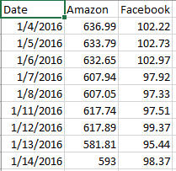
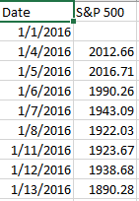
Project working model:-
Step 1: Gather S&P(Stock Price) dataset of assets we want to buy and clean it.
Stock_data.csv
benchmark_data.csv
Notes:
S & P means Stock Price.

Slide 10
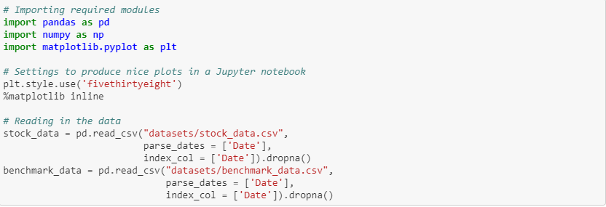
Project working model(cont):-
Step 2: Import libraries and dataset into code editor.
Notes:
S & P means Stock Price.

Slide 11
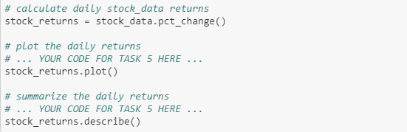
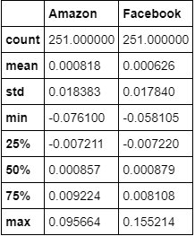
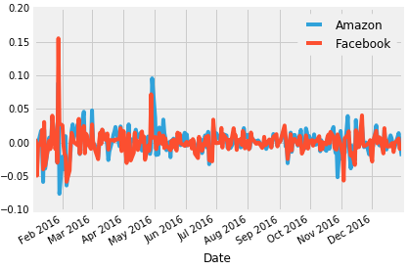
Project working model(cont):-
Step 3: computing the percentage change in value from one day to the next of stocks.
Notes:
S & P means Stock Price.

Slide 12
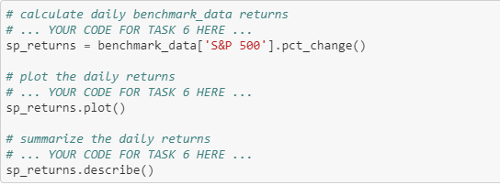
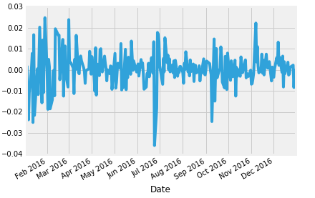
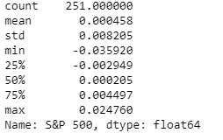
Project working model(cont):-
Step 4: computing the percentage change in value from one day to the next of S&P 500.
Notes:
S & P means Stock Price.

Slide 13
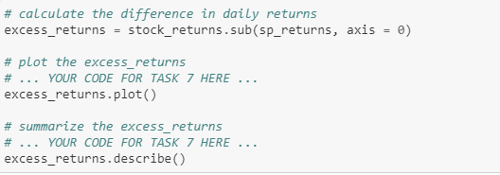
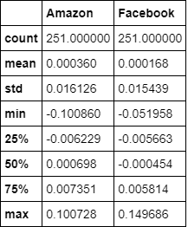
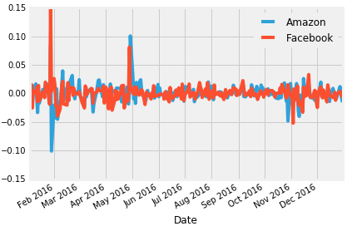
Project working model(cont):-
Step 5: computing the relative performance of stocks vs. the S&P 500 benchmark.(stock_returns - sp_returns for each day).
Notes:
S & P means Stock Price.

Slide 14
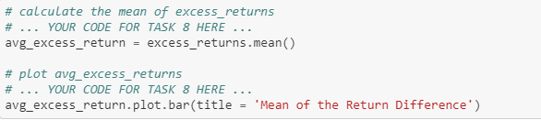
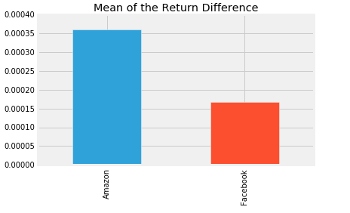
Project working model(cont):-
Step 6: computing the Average difference in daily returns Stocks vs S&P 500.
Notes:
S & P means Stock Price.

Slide 15
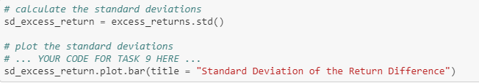
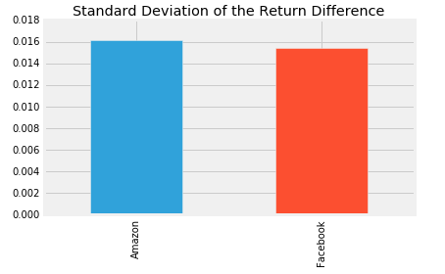
Project working model(cont):-
Step 7: compute Standard Deviation of the Return Difference.
Notes:
S & P means Stock Price.

Slide 16
Project working model(cont):-
Step 8: computing the ratio of Average difference and Standard deviation. This is Sharpe ratio of daily returns.
Notes:
S & P means Stock Price.

Slide 17
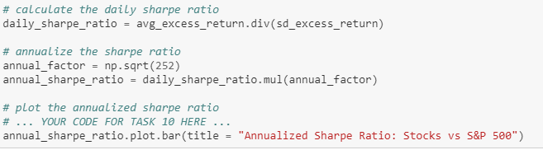
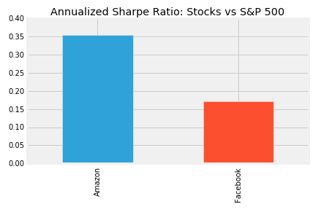
Project working model(cont):-
Step 9: compute Annualized Sharpe Ration by multiplying Daily Sharpe Ratio with sqrt of no.of trading days.
(trading days=252 (5 days, 52 weeks, minus a few holidays))
Notes:
S & P means Stock Price.

Slide 18
Advantages:-
Investors can use this project to determine whether to buy an asset or not. Using this they can avoid loss of investment.
Notes:
S & P means Stock Price.

Slide 19
Disadvantages:-
High Configuration system is required to speed up execution which is a reason for not making it remote now.
Notes:
S & P means Stock Price.

Slide 20
Future Implementation:-
In future, we will make it accessible through web interface. So that it can be accessed by any one.
Notes:
S & P means Stock Price.

Slide 21
Conclusion:-
Even though it is classifying, we are not taking market trend into consideration. So we will incorporate market trends for better accuracy.
Notes:
S & P means Stock Price.

Slide 22


